Slide 1
Enhancing Performance Of Operating System Using Machine Learning
Project Members:
1. Lakshay Bansal (287/CO/12)
2. Ravish Mahur (339/CO/12)
3. Rishab Banerjee (340/CO/12)

Slide 2
ABSTRACT
There is no single scheduling or memory management algorithm that could provide good performance consistently under varying environment –Being affected by workload(type and size of Program/data), file system, disk system.
Therefore, a new self learning approach is proposed which can adapt to various types of workloads, and make decisions for optimizing the performance of the OS.

Slide 3
Work Hitherto
Courses Done
Machine Learning (Dr. Andrew Ng, Stanford University)
Introduction To Data Science (Dr. Bill Howe, Washington University)
Artificial Intelligence(UC Berkeley)
R Programming (Dr. Roger Peng, John Hopkins )
Introduction To Linux (edX)
Research Papers Read
Self Learning Disk Scheduling (IEEE)
Applying Machine Learning Techniques to improve Linux Process Scheduling (IEEE)
To Collect Or Not to Collect? Machine Learning For Memory Management ()
Dynamic Multicore Resource Management: A Machine Learning Approach

Slide 4
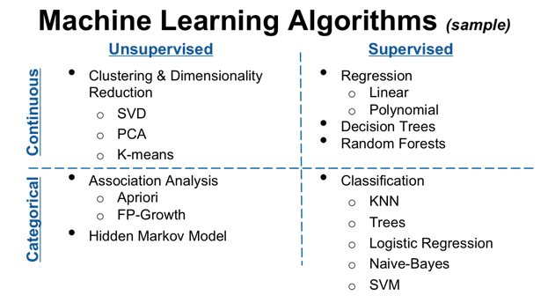
Machine Learning Algorithms

Slide 5
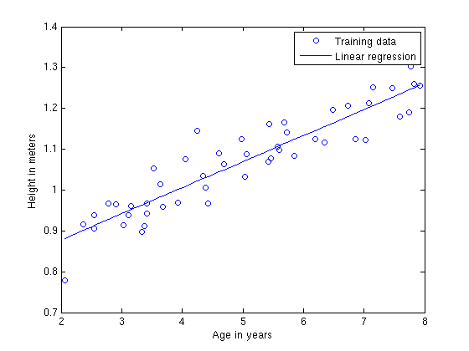
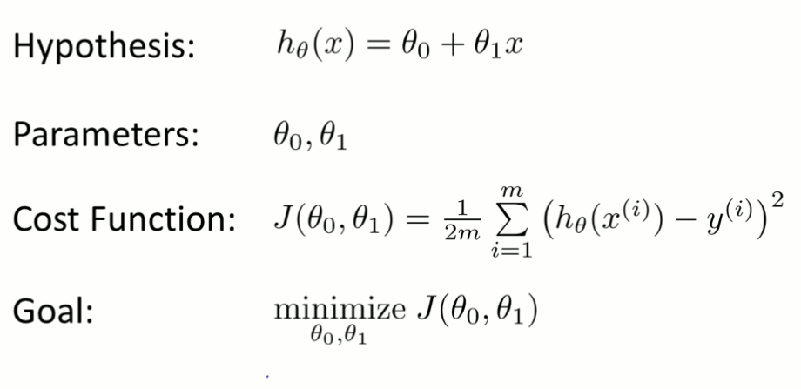
Linear Regression
Regression is used to predict scalar (continuous) values given some inputs.
A cost function ,called "Squared error function" is used to find the accuracy of the hypothesis function.
Gradient Descent or Normal Equation can be used to find the values of parameters (theta 1 and theta 2) that minimize the cost function.

Slide 6
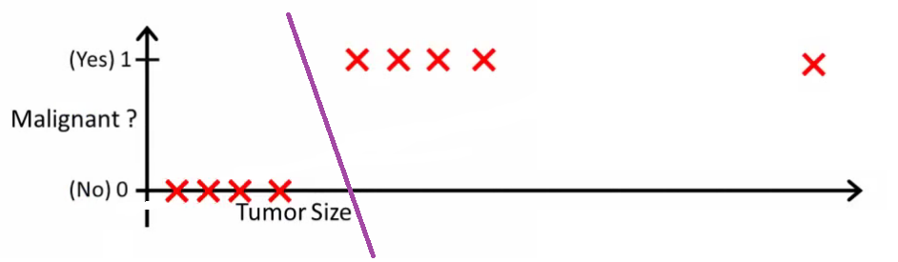
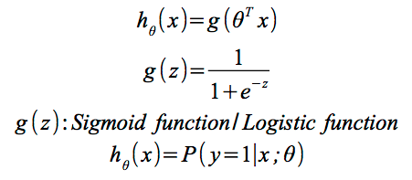
Logistic Regression
Is a statistical classification model
Predicts binary response from a binary predictor for predicting the outcome of a categorical dependent variable
Applications :
  Predict whether a voter will vote for Congress or BJP based on age, income, gender, caste etc
  Predict whether a tumour is malignant or benign
  Whether a job is IO bound or CPU bound

Slide 7
Neural Networks

Slide 8
CLUSTERING
Support Vector Machines
K-Means

Slide 9
FOCUS AREAS
Optimize the performance of the following aspects of OS:
Process Scheduling
Memory Management
Disk Scheduling
Cache Replacement
etc...

Slide 10
PROCESS SCHEDULING
Intuition
Generally process schedulers allocate CPU time slices to a process according to a scheduling algorithm that does not use any previous execution history of the process. It might be possible to better utilize resources if we could “recognize” a program and predict its resource requirements.
Approach followed (in the research paper read):
Predictive scheduling based on decision trees using static and dynamic attributes (size of program, data size, type of imput etc) reduced the TaT by about 6%. This was due to a reduction in the number of context switches needed to complete the process execution.
Modifications/ Improvements Possible:
Application of other techniques like neural networks and comparison of the overheads and performance and find the best possible alternative.

Slide 11
MEMORY MANAGEMENT

Slide 12

DISK SCHEDULING
Self-learning disk scheduling schemes
Change-Sensing Round-Robin Selection
Feedback Learning
Per-Request Disk I/O Scheduler
Two-Layer Combined Learning Scheduler (Best Performance) - It employs feedback learning techniques to analyze workloads, change scheduling policy, and tune scheduling parameters automatically. We discuss schemes to choose features for workload learning, divide and recognize workloads, generate training data, and integrate machine learning algorithms into the Two-layer Learning Scheme

Slide 13
Adaptive Replacement Cache
Algorithm
The self-tuning, low-overhead, scan-resistant adaptive replacement cache algorithm outperforms the least-recently-used algorithm by dynamically responding to changing access patterns and continually balancing between workload recency and frequency features
ARC maintains two LRU pages lists: L1 and L2.L1 maintains pages that have been seen only once, recently, while L2 maintains pages that have been seen at least twice, recently. Hence, we say that L1 captures recency, while L2 captures frequency.
ARC adapts quickly and effectively to a variable workload size. A real-life implementation revealed that ARC has a low space overhead—0.75 percent of the cache size. Also, unlike LRU, ARC is scanresistant in that it allows one-time sequential requests to pass through without polluting the cache or flushing pages that have temporal locality.
Likewise, ARC also effectively handles long periods of low temporal locality

